Slide 1
AML PROJECT 2022/2023 Graph Network-based Simulator (GNS) for Human Pose Forecasting
Francesco Bonanni
Eleonora Turchetti
Vincenzo Romito
Theo Courbis

Slide 2
Task and dataset
Human Pose Forecasting using a Graph Network-based Simulator (GNS)
Datasets: Human3.6M (http://vision.imar.ro/human3.6m/)
Split based on current literature
S11 for validation.
S5 for testing.
All the others for training
Metric: MPJPE (Mean Per Joint Position Error)
Benchmark: STS-GCN results
Resources:
https://github.com/FraLuca/STSGCN
https://github.com/deepmind/deepmind-research/tree/master/learning_to_simulate
https://github.com/geoelements/gns

Slide 3
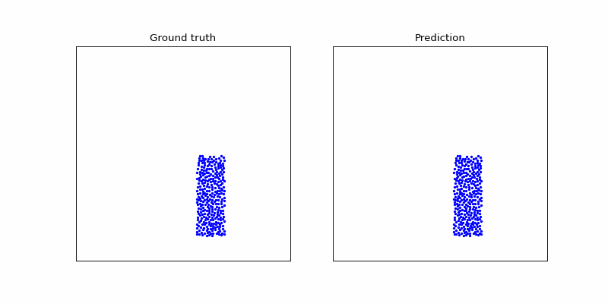
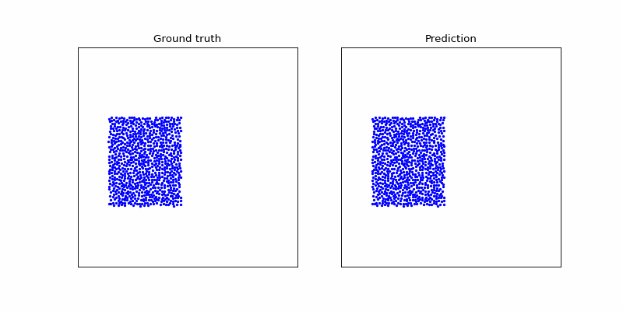
Learning to Simulate Complex Physics with Graph Networks​ (arXiv:2002.09405v2 [cs.LG] 14 Sep 2020)

Slide 4
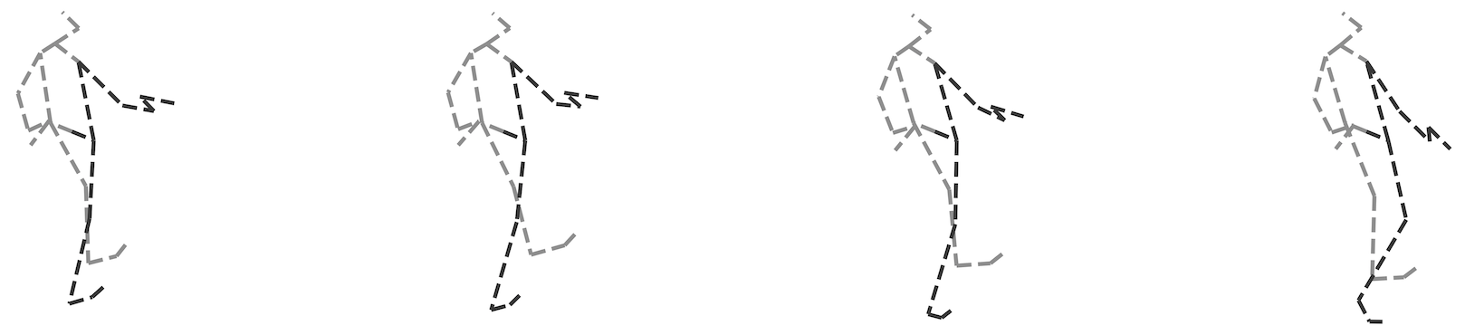
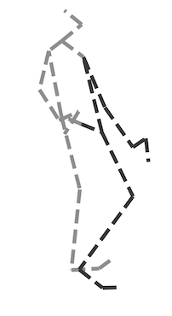
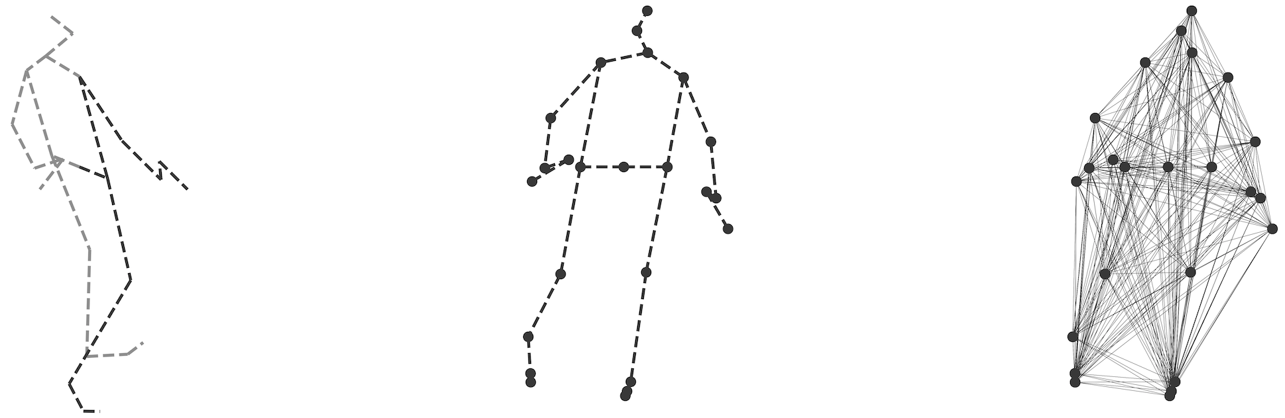
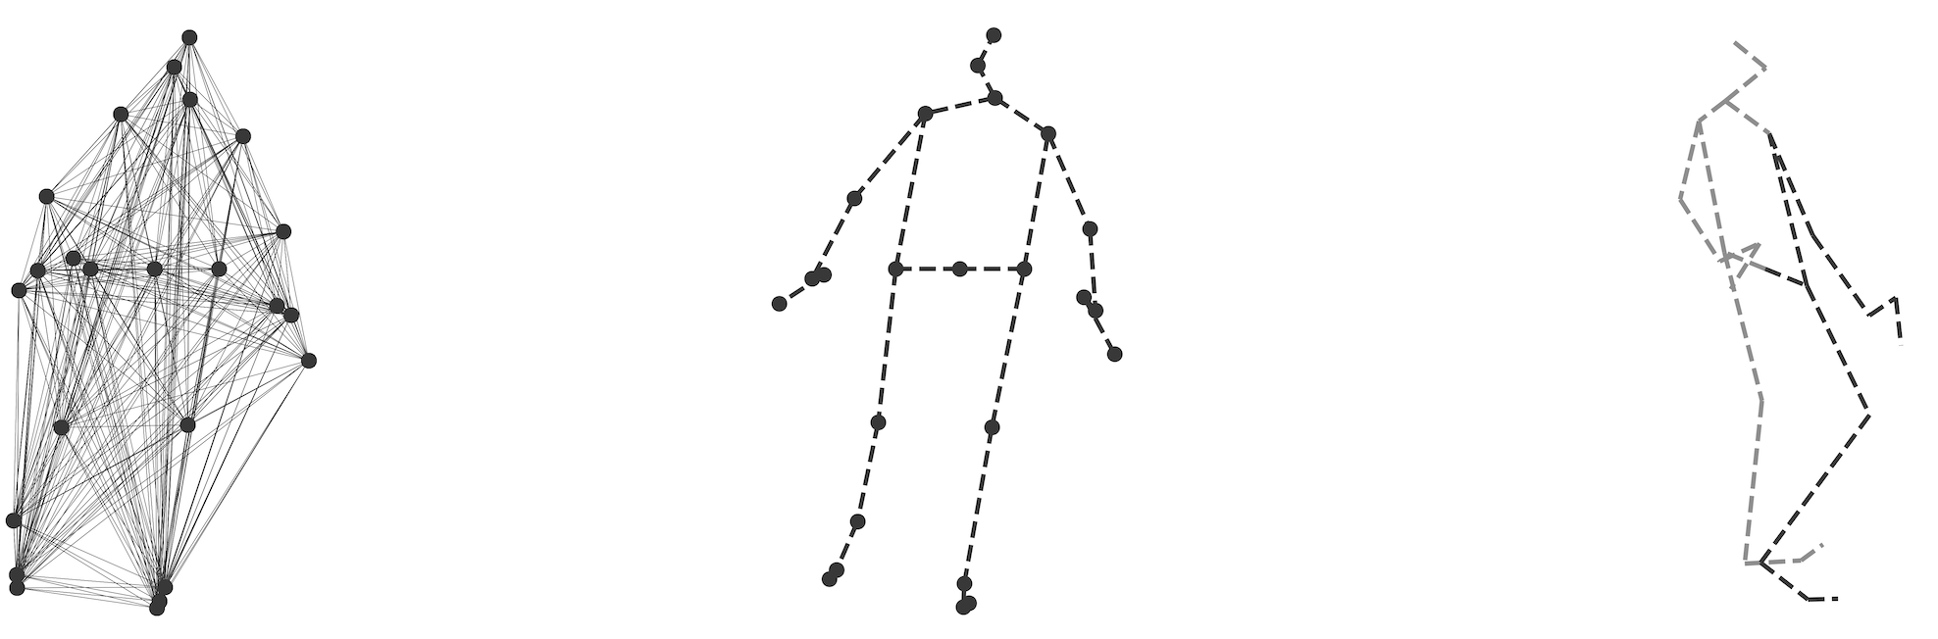
Model architecture
Input sequence
Predicted pose
GNS
Encoder
Processor
Decoder

Slide 5
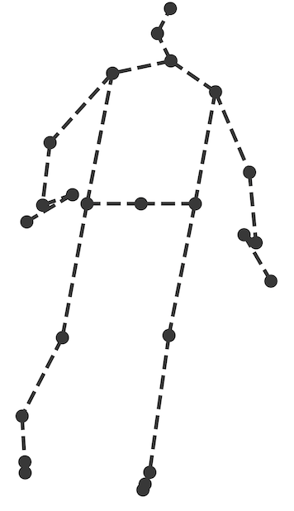
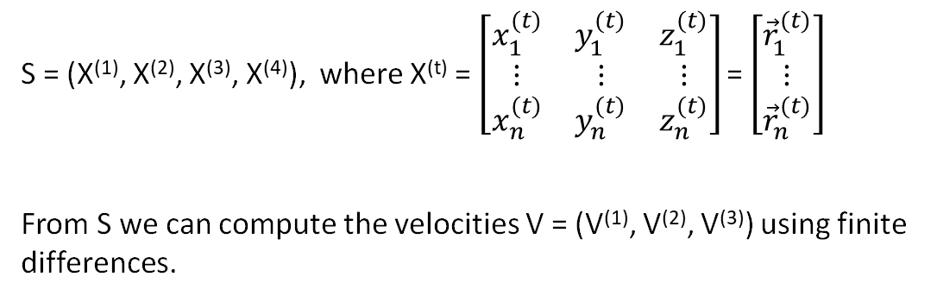
Model architecture - Encoder
G = (V, E)
t₁
t₂
t₃
t₄
e_{ij} = (r_{i}⁽⁴⁾ - r_{j}⁽⁴⁾, ||r_{i}⁽⁴⁾ - r_{j}⁽⁴⁾||)
v_{i} = (v_{i}⁽¹⁾, v_{i}⁽²⁾, v_{i}⁽³⁾)
v_{j}

Slide 6
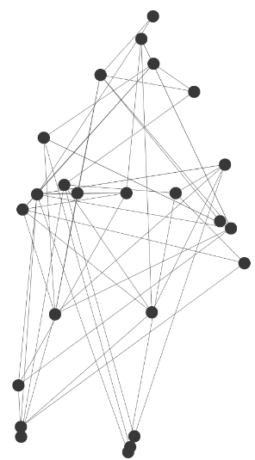
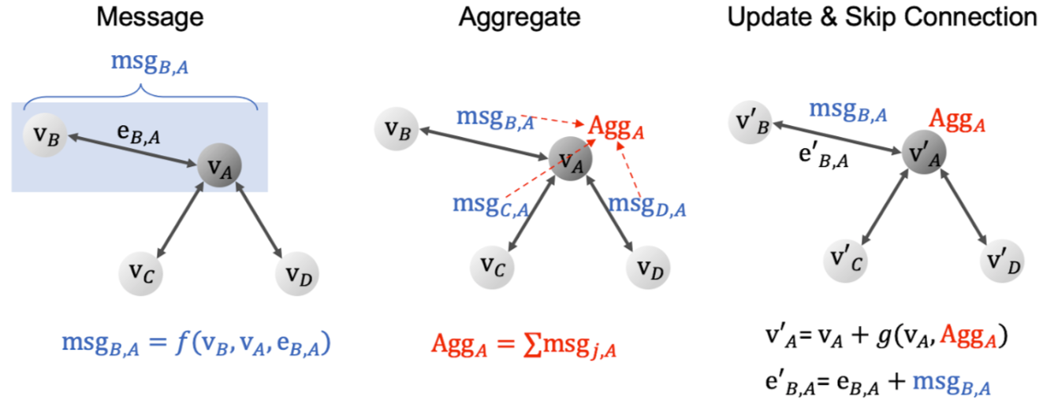
Model architecture - Processor
N times

Slide 7
Model architecture - Processor
N times

Slide 8
Model architecture - Decoder
v_{i}
r_{i}

Slide 9
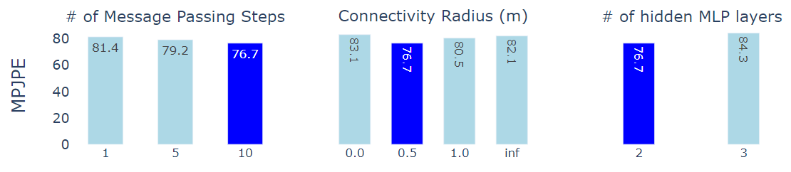
Hyperparameter Search

Slide 10
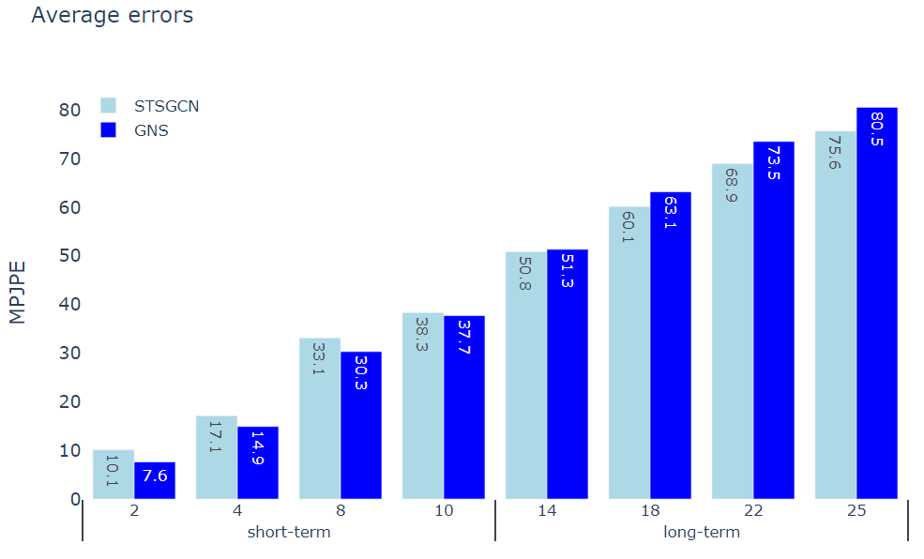
Quantitative results

Slide 11
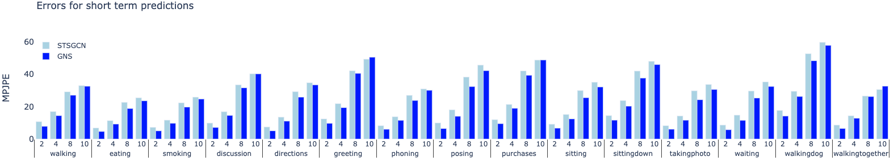
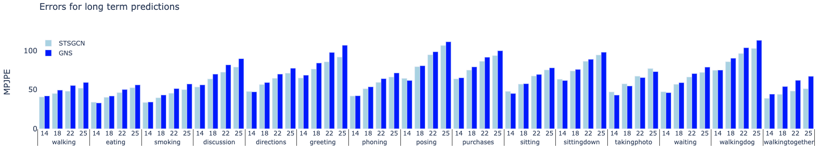
Quantitative results

Slide 12
Experiments with noise – based on DeepMind approach
Autoregressive models suffer from accumulation of errors over long-term predictions
We corrupt the input velocities of the model using a random-walk noise, with different standard deviations of the noise (0, 3e-4, 6.7e-4, 3e-5)
The performances get worse in every case errors accumulation in the prediction cannot be modeled using a random-walk.

Slide 13
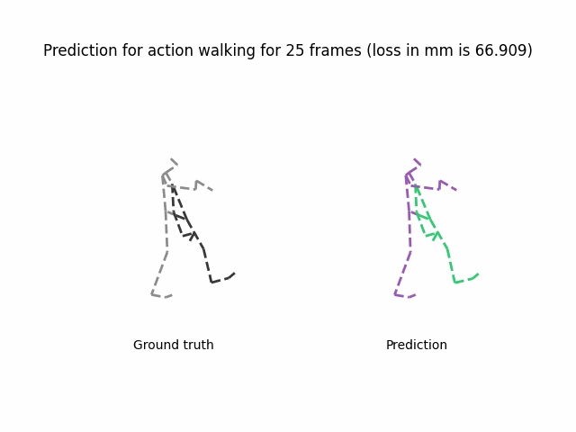
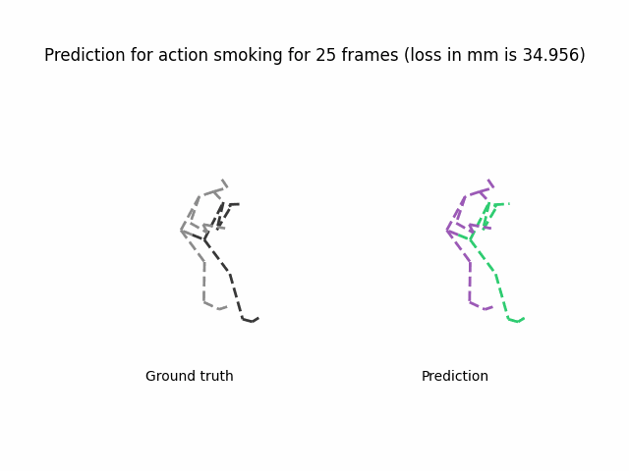
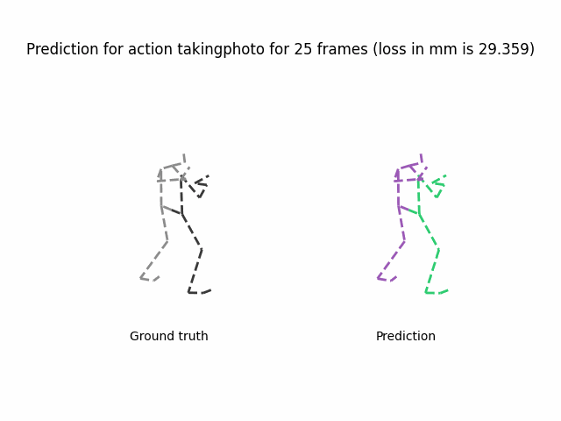
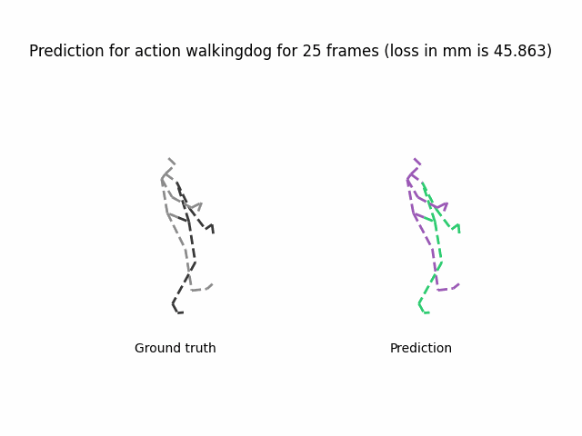
Qualitative results

Slide 14
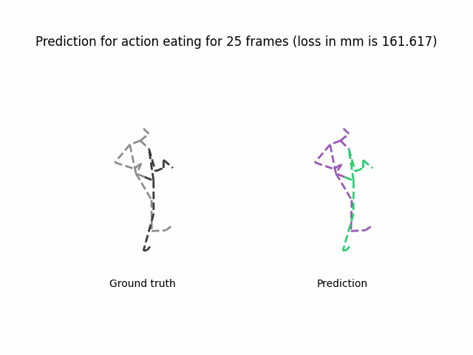
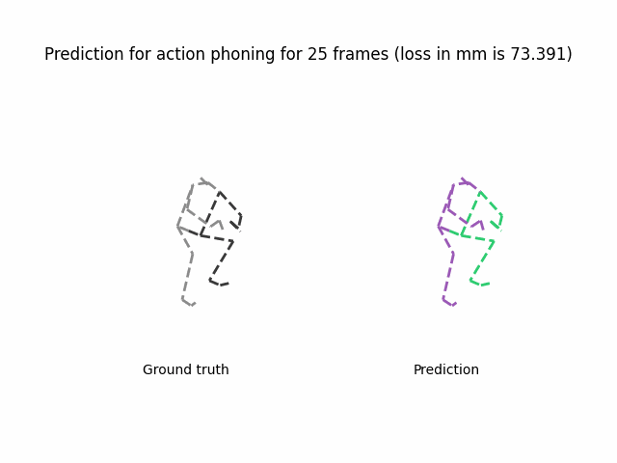
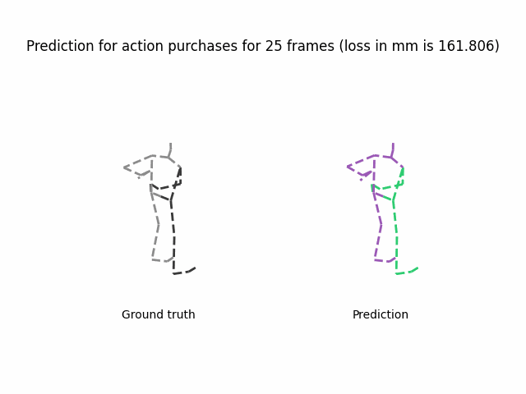
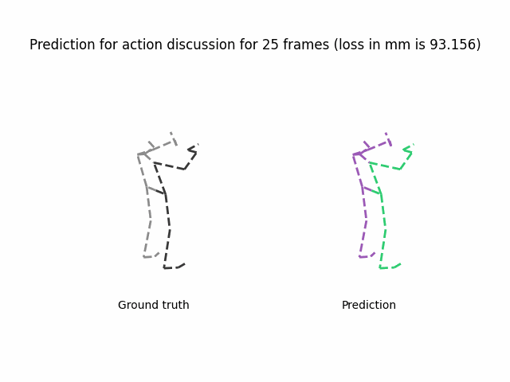
Example of failure cases

Slide 15
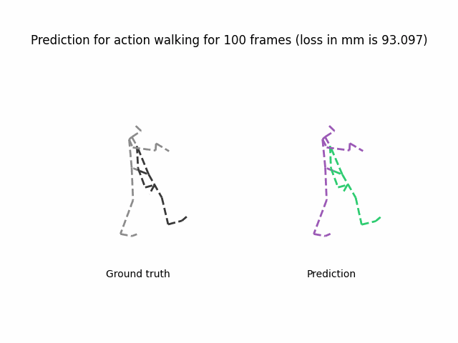
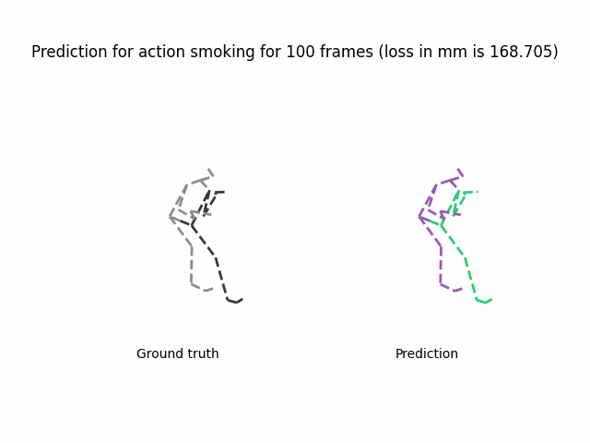
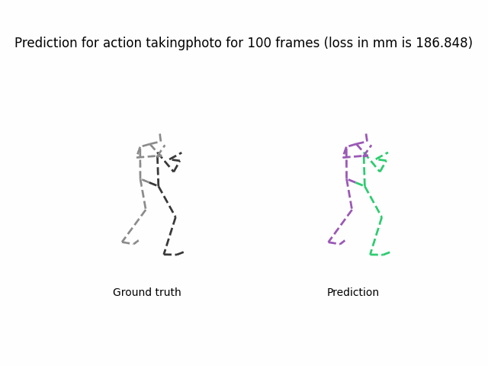
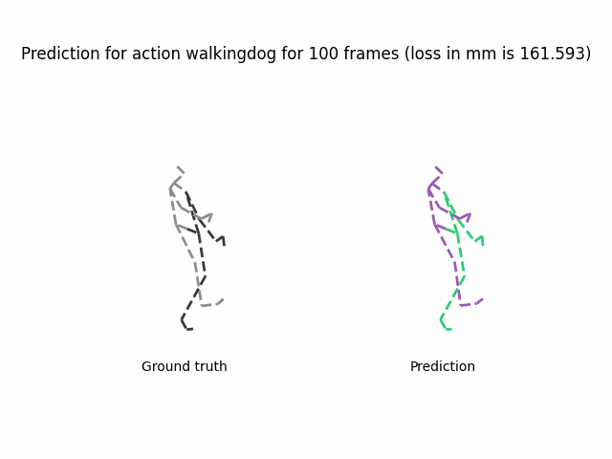
Experiments with longer prediction time

Slide 16
THANK YOU

Slide 17
Implementation differences
Our Implementation VS DeepMind implementation:
we removed boundaries features, external fields and particle types
we only predict velocities instead of accelerations
Our Implementation VS STS-GCN implementation:
train losses are computed on the velocities instead of position
autoregressive VS one-shot model

Slide 18
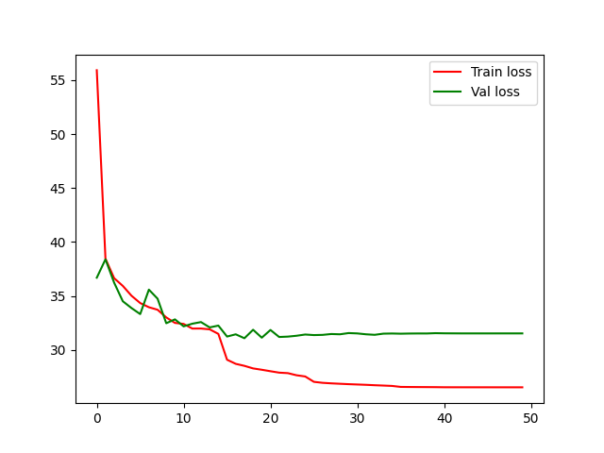
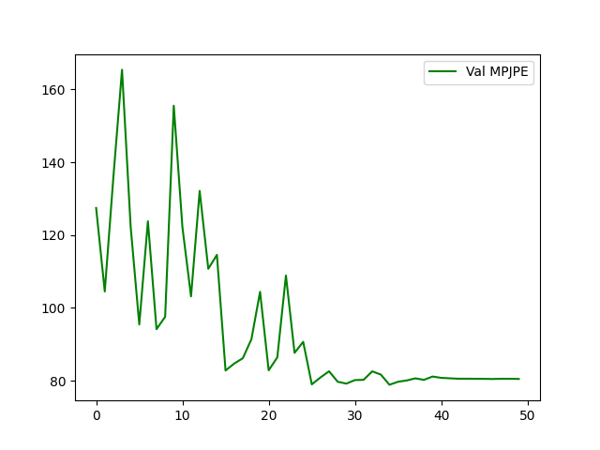
Implementation details
number of epochs: 50
hidden mlp dimension: 128
optimizer: same as STS-GCN (we will experiment with a different one)
MPJPE
||v - v*||^2
epochs
epochs

Slide 19
Other experimental observations
High connectivity radius yield low MPJPE on short-term and high MPJPE on long-term sequences
Predicting directly positions does not yield better performances
Varying input dimension does not yield better results after 10.

